Slide 1

College Freshman and Eating
Jeffrey Qiu, Andrew Tang, Jennifer Konishi, Lily Liu, Melody Yeung, Evan Hao

Slide 2
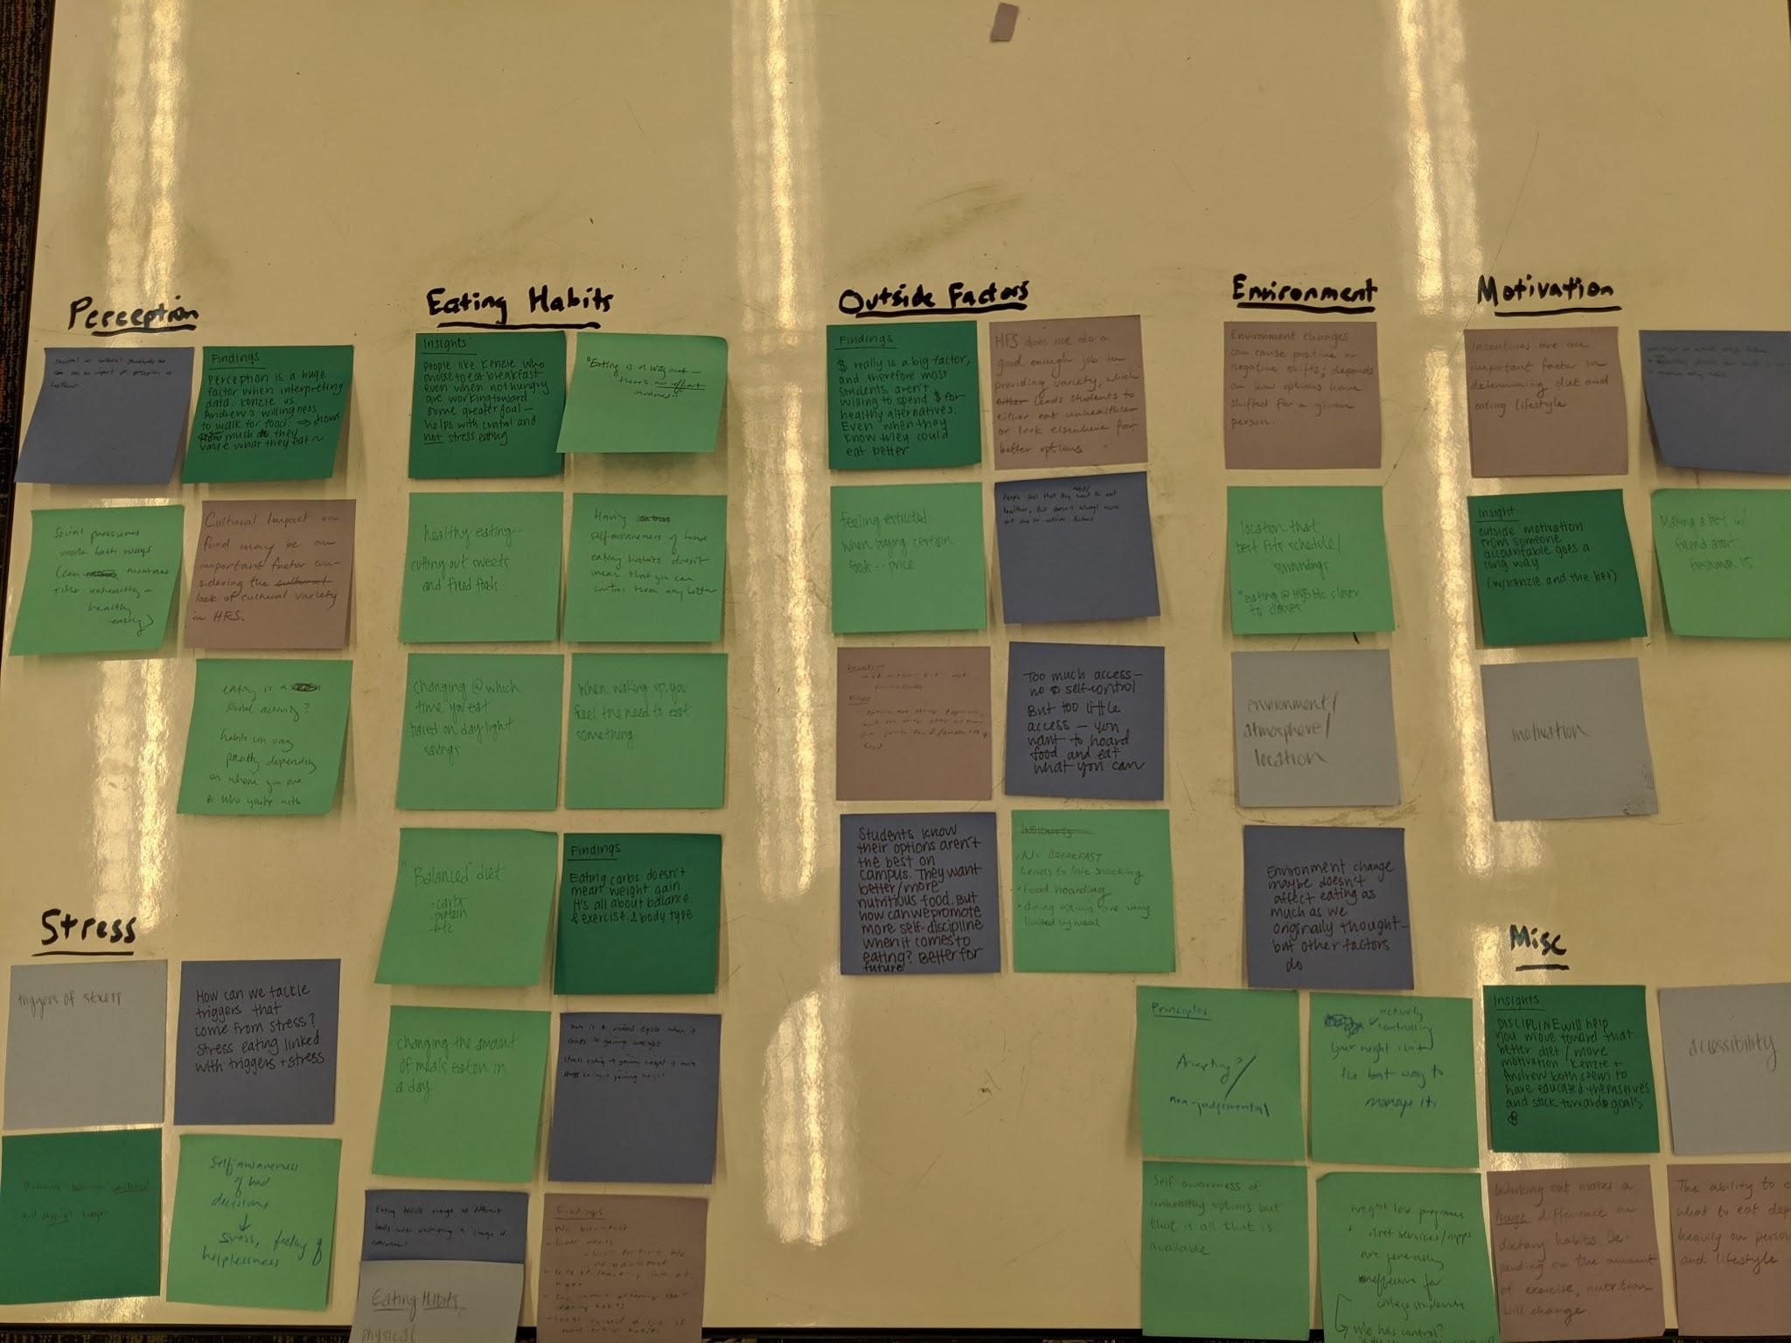
The Problem
College freshman, while transitioning into college, have:
- newfound freedom with making their own decisions
- increased levels of stress
- exposure to dieting, nutrition, and health.
Inaccurate perception of health
Developing unhealthy eating habits including binge eating and stress eating, giving into cravings etc.
Outside factors like cost, location, convenience
Notes:
Jeffrey- https://www.isixsigma.com/new-to-six-sigma/getting-started/how-to-write-an-effective-problem-statement/ https://uxplanet.org/designers-indispensable-skill-the-ability-to-write-and-present-a-solid-problem-statement-56a8b4b8060
Lack healthy options under meal plan
Have new found freedom with making their own decisions- where, what and when to eat
Most are eating less often and snacking more often- binge eating
Address emotional side of things- new found levels of stress
Not having other ways to cope with the stress- stress eating

Slide 3
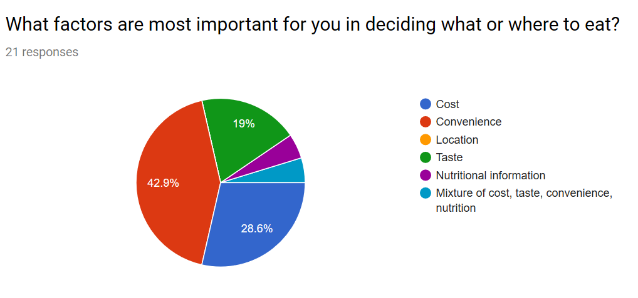
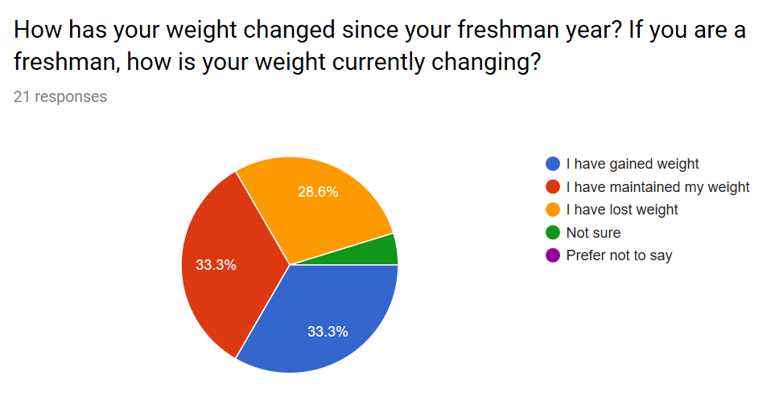
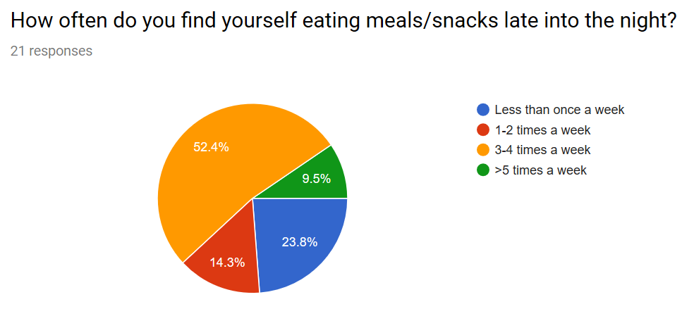
Survey
What factors do you consider when deciding where to eat?
How has your weight changed?
How often do you snack late into the night?
Notes:
Melody - why we chose those questions/collected the data and talk about other info we wanted to investigate further
The first method we used to collect information from our user group was through a survey. When we were first coming up with questions to ask, we were still at a process of narrowing down our focus between habits around diet and nutrition, stress eating, access to food, and environment. Because of that, we asked pretty general multiple choice questions regarding living a healthy lifestyle, and then used our 4 free response questions to gain a better understanding on each of those focuses.
57% of our responses came from sophomores, which was significant because they were the best candidate to reflect on their eating habits from freshmen year. One of our most insightful multiple choice questions was “What factors are most important for you in deciding what or where to eat?” Almost 43% of the responses said the factor of convenience, followed by 29% with cost. We decided to better clarify the specifics of convenience later in our interviews. We had other questions regarding weight change and eating habits, but we found our responses from the free response section were valuable because of their vulnerability and honesty. As expected, there were many complaints regarding HFS options, but we gained much insight on people’s perceptions around weight gain and paying for food, which ultimately helped us to narrow down our focus.
Moving forward, other information we want to investigate include our user group’s thoughts around how they approach living a healthy lifestyle, as well as how they feel about their current eating habits.

Slide 4
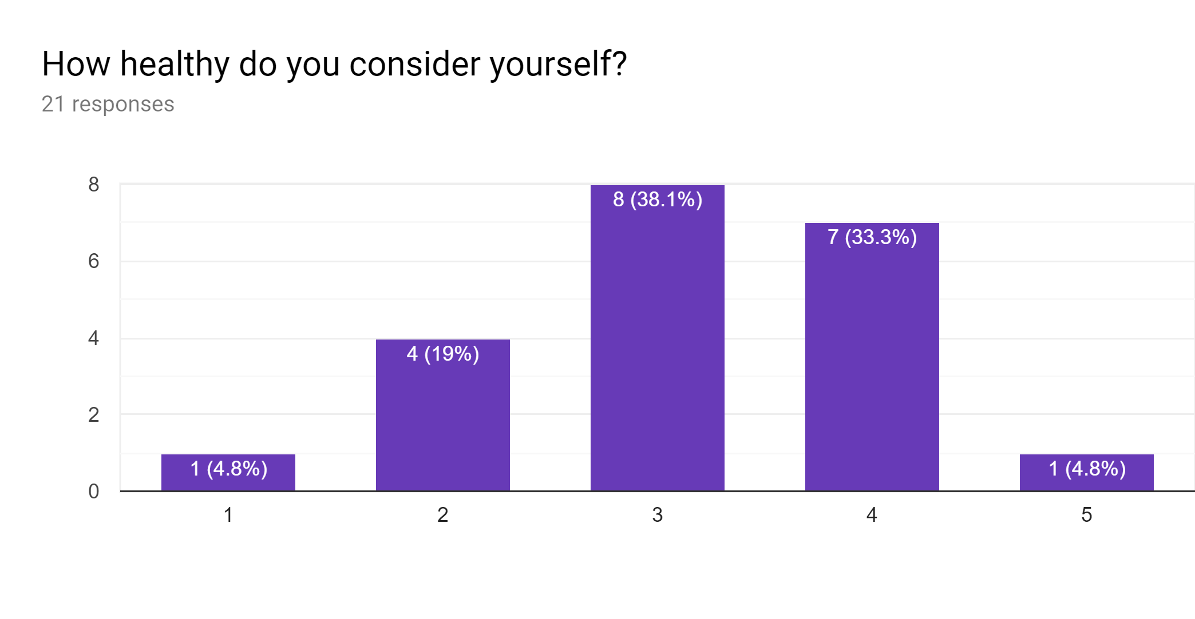
Survey
“
As the quarters progressed, I just stopped eating anything on campus to save money, but was also too lazy to make food and bring it to school.
”
How healthy do you consider yourself?
“
My eating habits have fluctuated.
I gained a lot of weight during my freshman year, but then I also lost a lot more weight. I tend to stress eat, so I eat more junk food. I also eat at weird times and sometimes go almost all day without eating.
”
1 - very unhealthy 5 - very healthy
Notes:
Melody - why we chose those questions/collected the data and talk about other info we wanted to investigate further
The first method we used to collect information from our user group was through a survey. When we were first coming up with questions to ask, we were still at a process of narrowing down our focus between habits around diet and nutrition, stress eating, access to food, and environment. Because of that, we asked pretty general multiple choice questions regarding living a healthy lifestyle, and then used our 4 free response questions to gain a better understanding on each of those focuses.
57% of our responses came from sophomores, which was significant because they were the best candidate to reflect on their eating habits from freshmen year. One of our most insightful multiple choice questions was “What factors are most important for you in deciding what or where to eat?” Almost 43% of the responses said the factor of convenience, followed by 29% with cost. We decided to better clarify the specifics of convenience later in our interviews. We had other questions regarding weight change and eating habits, but we found our responses from the free response section were valuable because of their vulnerability and honesty. As expected, there were many complaints regarding HFS options, but we gained much insight on people’s perceptions around weight gain and paying for food, which ultimately helped us to narrow down our focus.
Moving forward, other information we want to investigate include our user group’s thoughts around how they approach living a healthy lifestyle, as well as how they feel about their current eating habits.

Slide 5



Participant Interviews
Person 1
Person 2
Person 3
Environment causes change in diet
Stress eating through anxiety and exams
Previous environment was less healthy
Improved eating habits in college, Incentive
Control - peer pressure, choice of food
Convenience can determine options
Notes:
Andrew -- interviewee quotes, most important thing learned/found

Slide 6
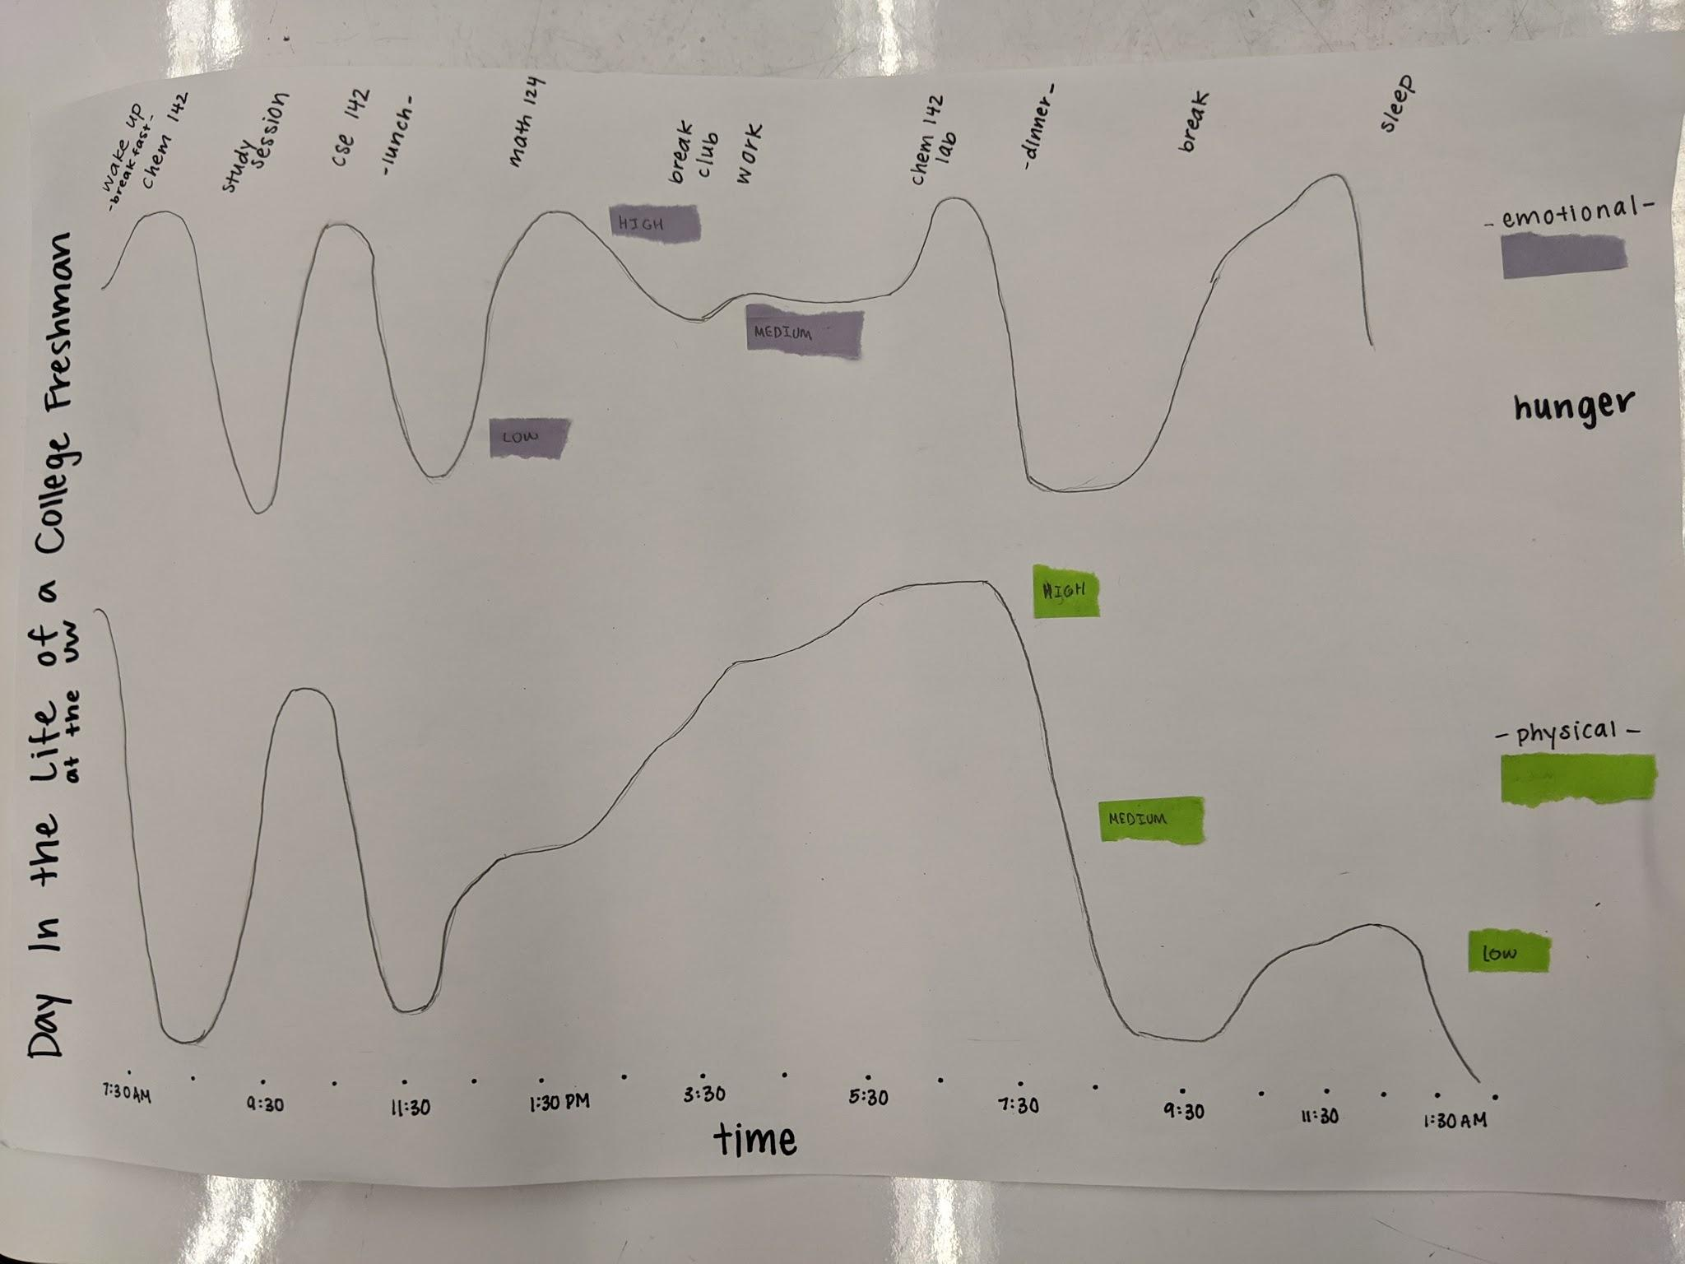
Experience Journey Map
Notes:
Jeffrey- Experience Journey Map
Tracked emotional and physical hunger
Noticed that there isn’t much of a correlation between them like one could be emotionally hungry even after quenching physical hunger
Emotional hunger spikes so one moment someone can have high levels and another have little to none

Slide 7
How Might We...
Notes:
Lily

Slide 8
help college students to more accurately perceive their health to better understand how their eating habits are
impacting their health?
suggest methods of healthy eating to encourage college freshmen to think critically about their eating habits?
help college freshman to make healthier, more informed choices in order to better define their relationship with food?
Notes:
3rd one** -- urge to notice what they’re doing, and how to move forward
Explore relationship b/w current state and eating habits
Depends on process, correlate with food
2nd question → 3rd question -- redefine relationship with food
Broaden out?
Perception of health fall under design principle of statement
Think critically of what you’re eating
Emotional and physical hunger - different, not correlated!
When they physical/emotionally eat -- lacking -- identify -- more research
Maintain healthy lifestyles -- HFS?
Wrap up research by first 2 weeks of winter quarter

Slide 9



Design Principles
Personalized
Long-Term
Integrated
Notes:
Jennifer -- why we chose them, why it matters, how it connects to our topic
Integrated: Fit’s into their routine/environment
Lot of times, exercise and health aren't usually their top priority, so if they can integrate it into their lives it’ll be easier for them plan out their day

Slide 10

What’s Next?
How Might We Statements
Existing Products
Ideation
Notes:
Evan
Stakeholders: college freshman

Slide 11
Thank You
We’d appreciate any feedback!

Slide 12

thank you :]

